Slide 1


EMPLOYEE MANAGEMENT SYSTEM
TEAM MEMBERS
AKANKSHA KUMARI
CH PAWAN KUMAR
DHESINGURAJA
D KAVITHA

Slide 2
INTRODUCTION
This software application stores all the employee's information in a database. It is an application developed in Java and the database used is SQL. It contains employee information like employee id, name, date of joining, and basic pay.
It is an easy-to-use application and has a user-friendly interface. It is totally built at the administrative end which means that only the admin has access rights to change or modify any records. So, this makes it a safe and reliable application to use.
The main aim of developing this application was to reduce the errors that occur in the manual system. One can search the details easily by just entering an employee id. In earlier systems, there was not such a facility to do so. All the details are stored in an SQL database. It is easy to update any employee details. All the employee records are integrated and so this makes it a user-friendly and easy to use application.

Slide 3
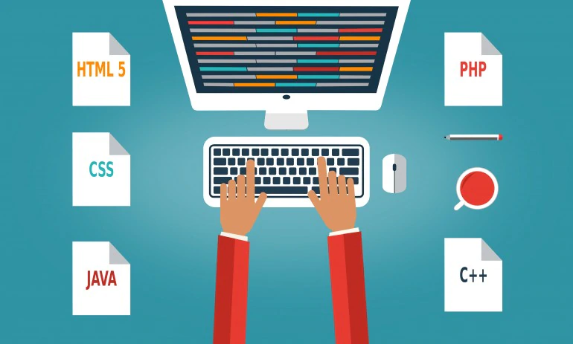
TECHNOLOGY
Backend : Spring Data JPA , Spring Boot-2.6.4
Frontend :Angular -8, CSS-3 , Html -5
Database : Oracle -11g
Server: Tomcat -8.5

Slide 4
Architecture Diagram
Component
Service
Presentation Layer
(UI Components)
Template
Directive
Configuration
Controller
Application Layer
(Web-Server Classes)
Service
Rest Controller
Entity/Model class
Repository classes
Data Access Layer
Oracle 11g Database

Slide 5
Control flow
LOG OUT
EDIT
EMPLOYEE
ADD EMPLOYEE
LOG IN
HOME
SEARCH BY ID
EMPLOYEE DETAILS
GET ALL EMPLOYEE
DELETE EMPLOYEE
REGISTRATION
EMPLOYEE DETAILS

Slide 6
CONCLUSION
The entire implemented system mainly demonstrates the concept of Employee management system.
This project helps the user to get the user details including basic pay , DA, HRA , gross , Net and Tax.
The developed system perfectly met all the objectives conceived at the design phase of the system.

Slide 7
THANK YOU

